Slide 1
TRENDS IN OPEN SOURCE AI MODELS (2025-2026)
HUGGING FACE

Slide 2

INTRODUCTION
Hugging Face is an open-source AI platform that hosts and distributes machine learning models, datasets, and tools for developers, researchers, and organizations worldwide.
The dataset used in this analysis was collected from publicly available model metadata on the Hugging Face platform. It combines cross-sectional and time-series analysis to understand what drives model popularity, growth momentum, and sustained adoption.

Slide 3
Problem statement
The AI model ecosystem is growing rapidly, but adoption is highly uneven. This project aims to analyze 550 Hugging Face models to understand what drives download growth, whether the ecosystem follows a winner-takes-all pattern, and how factors like organization type, country, modality, and growth stage influence model performance over time.
By examining organizational influence, geographic impact, modality trends, and lifecycle dynamics, the study uncovers structural patterns behind model success. The goal is to provide data-driven insights into how AI models scale, compete, and dominate in a rapidly expanding open-source landscape.

Slide 4
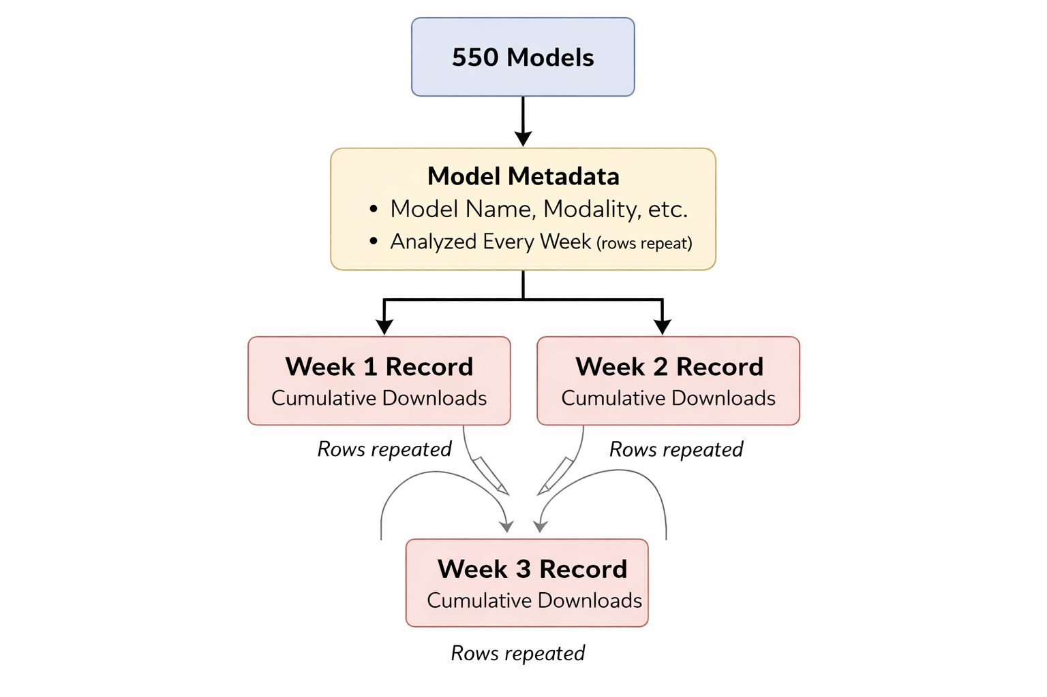
DATASET BREAKDOWN
The dataset was sourced from the Hugging Face open-source
model ecosystem and contains:
It includes:
Model metadata (author, organization type, country)
Popularity metrics (total downloads, annotators)
Modality and language information
Model lineage (derived from base models)
Time-series growth metrics (weekly growth, age stage)

Slide 5
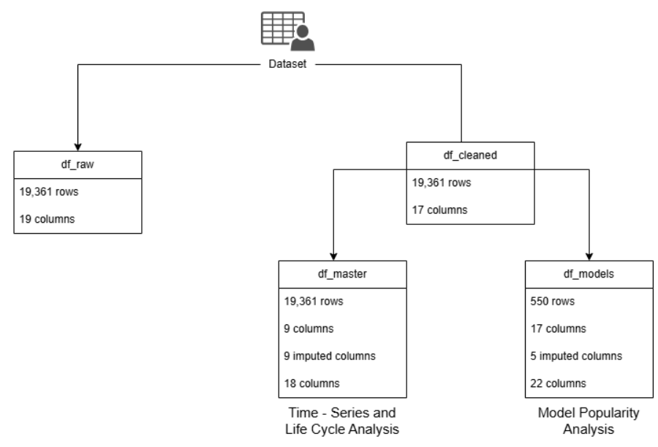
DATASET BREAKDOWN

Slide 6
OBJECTIVE
Analyze AI model adoption trends using download metrics to identify the most popular and fast-growing models.
Examine the geographic distribution of AI model development across countries and organizations.
Compare model modalities (Text, Image, Audio, Video, Multimodal) and study their usage patterns.
Identify the role of contributor types (users, teams, companies, free/community) in AI model creation.
Investigate model lineage and derivation, understanding how base models are reused or fine-tuned.
Perform time-based analysis to observe model release patterns and ecosystem growth over time.

Slide 7
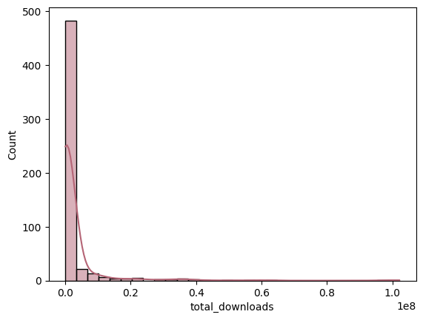
KEY FINDINGS
Downloads are extremely right-skewed → winner-takes-all ecosystem.

Slide 8
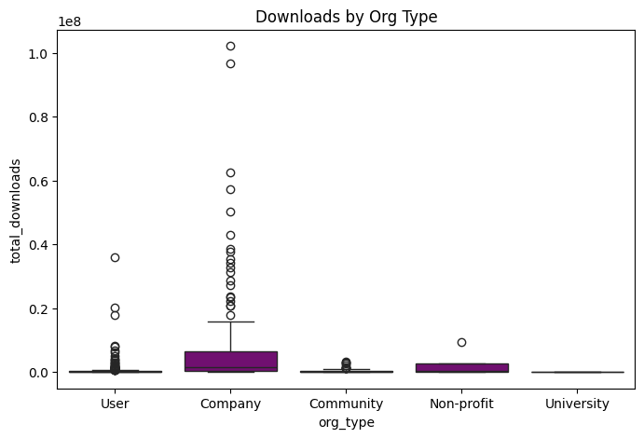
Organization impact
Company-developed models achieve higher median and extreme downloads.

Slide 9
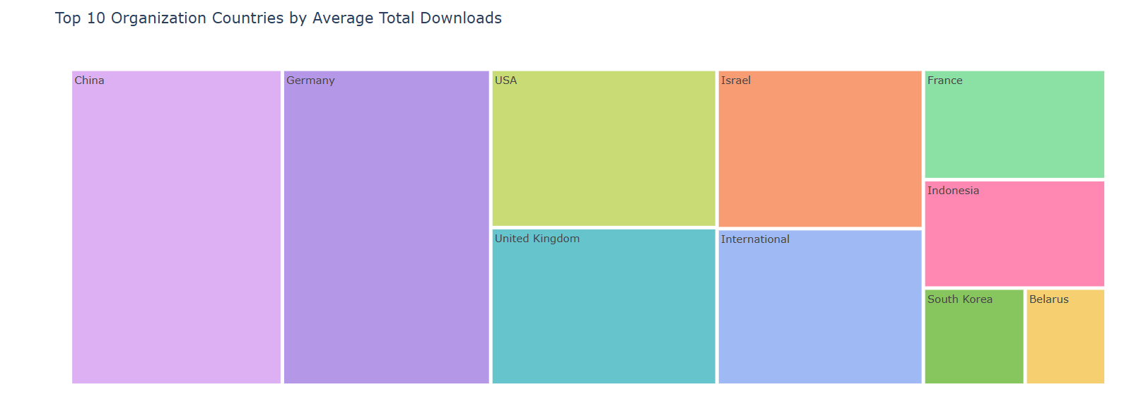
Geographical Impact
China, followed by Germany and a few countries dominate average performance of the models.
.

Slide 10
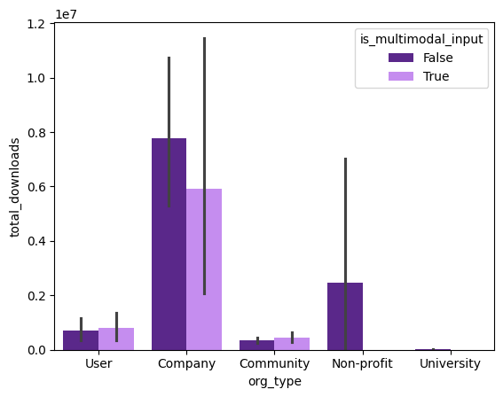
MODALITY IMPACT
Unimodal models currently outperform multimodal ones in adoption.

Slide 11
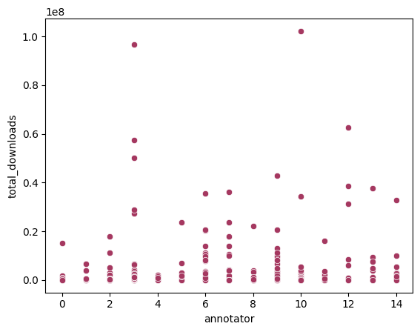
TEAM SIZE IMPACT
Downloads show weak correlation with annotator count.

Slide 12
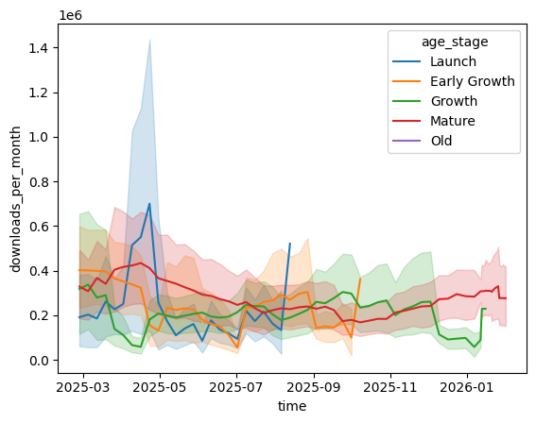
GROWTH STAGE PERFORMANCE
Launch Stage Shows Highest Volatility.
Early Growth stage models show strongest weekly momentum.
Mature Models Provide Stability.
Growth Stage Maintains Balanced Performance.
Old Models Show Declining or Low Activity.

Slide 13
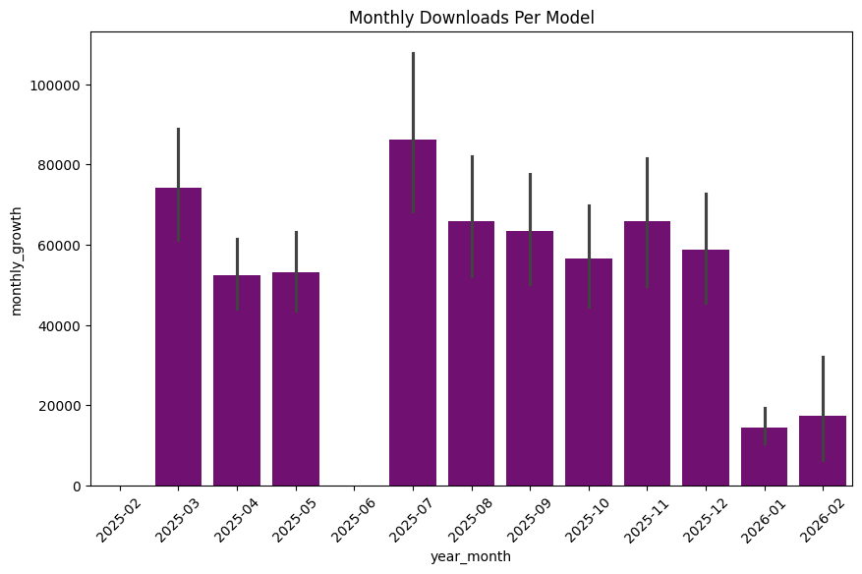
Monthly DOWNLOADS
Growth spikes occur during specific ecosystem surge periods

Slide 14
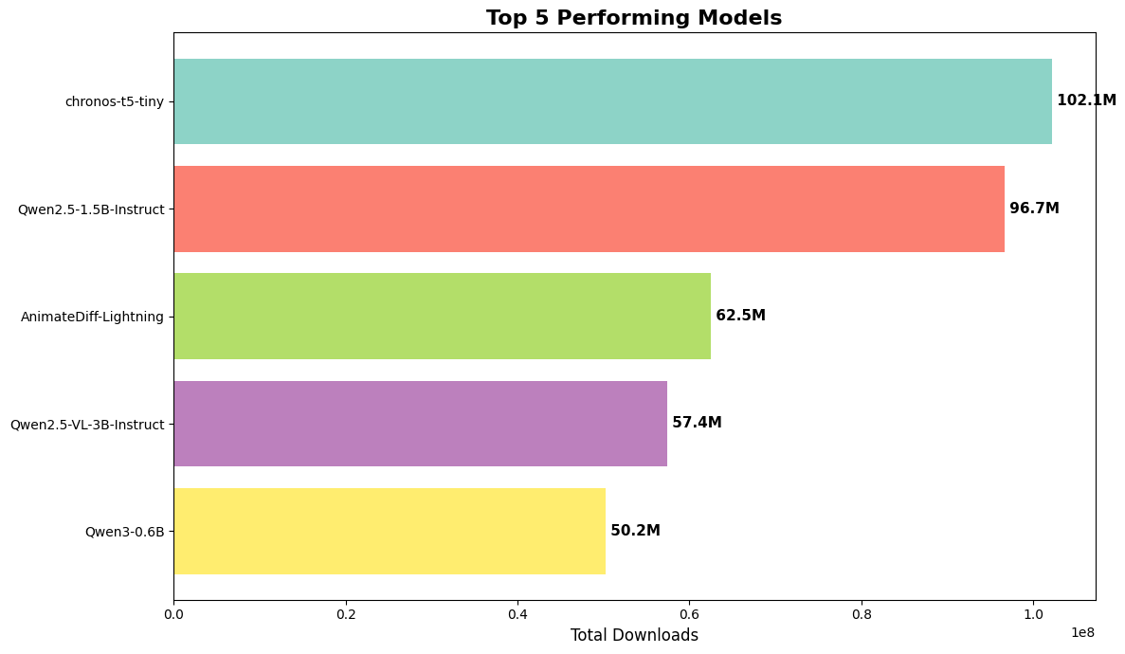
BEST PERFORMING MODELS
TOP 5 BEST PERFORMING MODELS

Slide 15
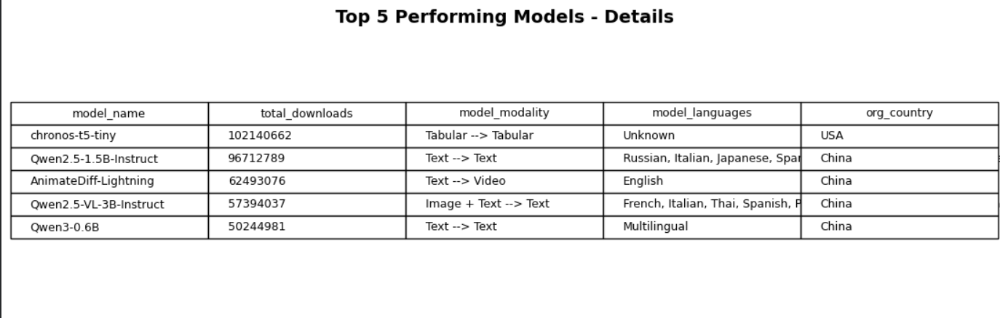
BEST PERFORMING MODEL

Slide 16
DECISION MAKING RECOMMENDATIONS
Build for Breakout Potential : In a winner-takes-all ecosystem, strategic concentration beats diversification.
Strengthen Institutional Backing : Organizational support significantly increases adoption probability.
Target High-Performance Regions : Geographic ecosystem maturity strongly impacts adoption success.
Prioritize Unimodal Excellence : Adoption favors simplicity and specialization over complexity.
Capitalize on Early Growth Momentum : Early-stage acceleration is critical for long-term dominance.
Leverage Ecosystem Surge Periods : Timing within ecosystem cycles significantly amplifies adoption.

Slide 17
Conclusion
The ecosystem is highly concentrated, performance-driven, and organization-influenced. Structural features alone do not determine success; instead, organizational backing, base-model quality, and early growth momentum play critical roles in sustained adoption.
This project provides a data-driven understanding of how open-source AI models evolve, scale, and compete within a rapidly expanding ecosystem.

Slide 18
TRENDS IN OPEN SOURCE AI MODELS – HUGGING FACE
THANK YOU
SHALINI K

